Slide 1

Gender Discrimination
University of Houston, College of Medicine
Team 7
Gabriella Angelina Lim
Justyn Phoa Zairen
Leow Ken Hing Bryan
Rodmond Tan Le Ming

Slide 2
Equal Pay Act
UH Med Policy
Promotion/Tenure Guidelines
Peer review process
Requirements
Teaching
Research
Service
Different wages for opposite genders
Employees perform substantially equal work
Performed under similar working conditions
Salary Guidelines
Based on rank, years in rank
Experience
Performance
Based on this information, we can narrow down our search to a few important factors:
Salary gap: Experience, Rank
Promotion gap: Certification, Number of Full/Asst Profs in each Department
Justyn

Slide 3
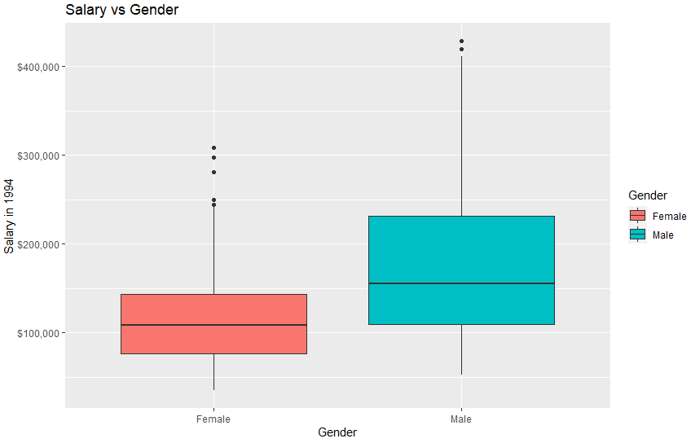
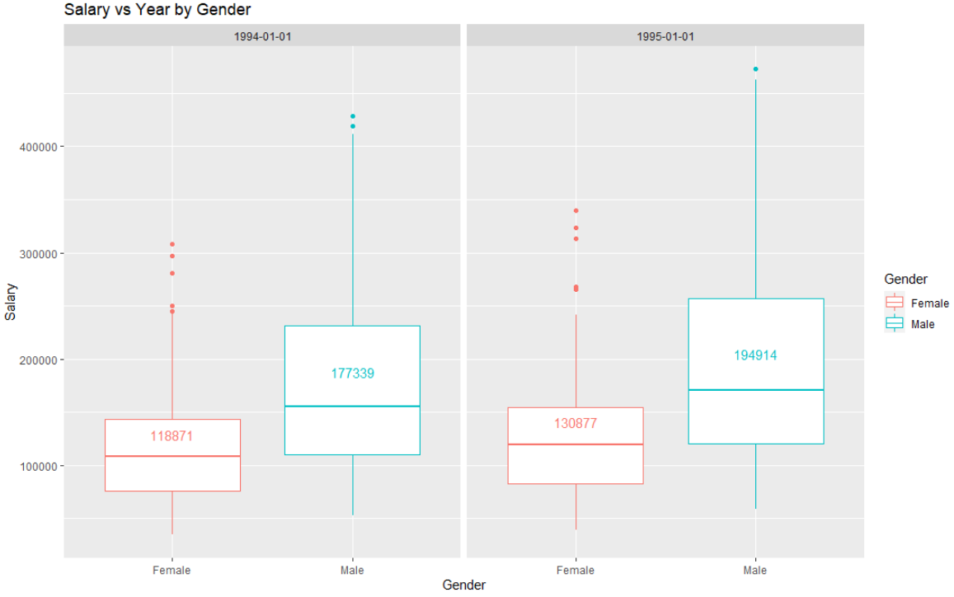
Analysis: Overall Salary
Overall average salary of males is significantly larger than that of females, and this salary gap is actually increasing year-on-year, with a $17,575 increase in male average salary and $12,006 increase in female average salary (46% disparity) from 1994 to 1995. This hints towards a worsening year-on-year gender wage gap.
Bryan

Slide 4
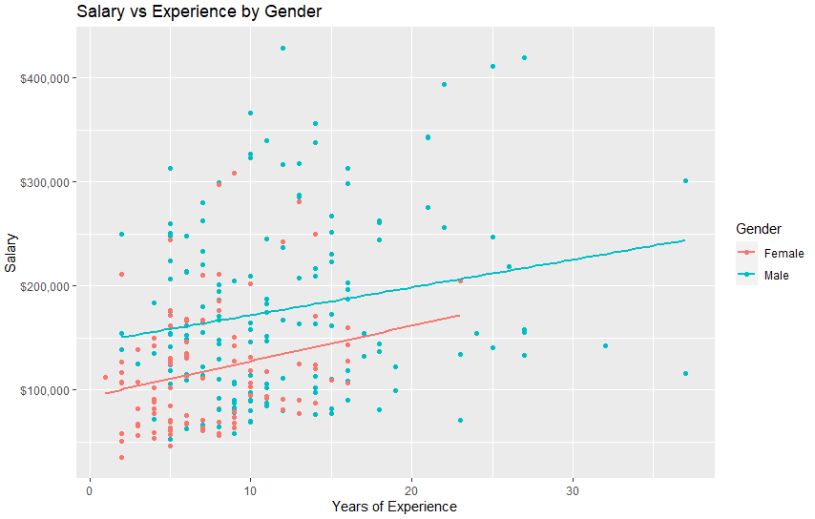
Analysis: Salary against Experience
Males get higher salaries than females across all levels of experience. Although the increase in salary with increase in experience for females is larger, it is insignificant and would require around 50+ years to catch up with males. This is not a reasonable time frame for the gender gap to close up.
Bryan

Slide 5
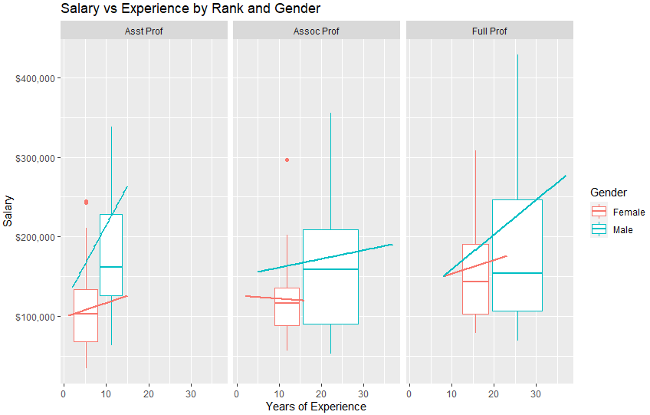
Analysis: Salary against Experience
Grouped by Rank
Across different ranks, and all experience levels, females get lower pay than males.
Salary increase for females is at a slower rate than males across all ranks.
Rodmond

Slide 6
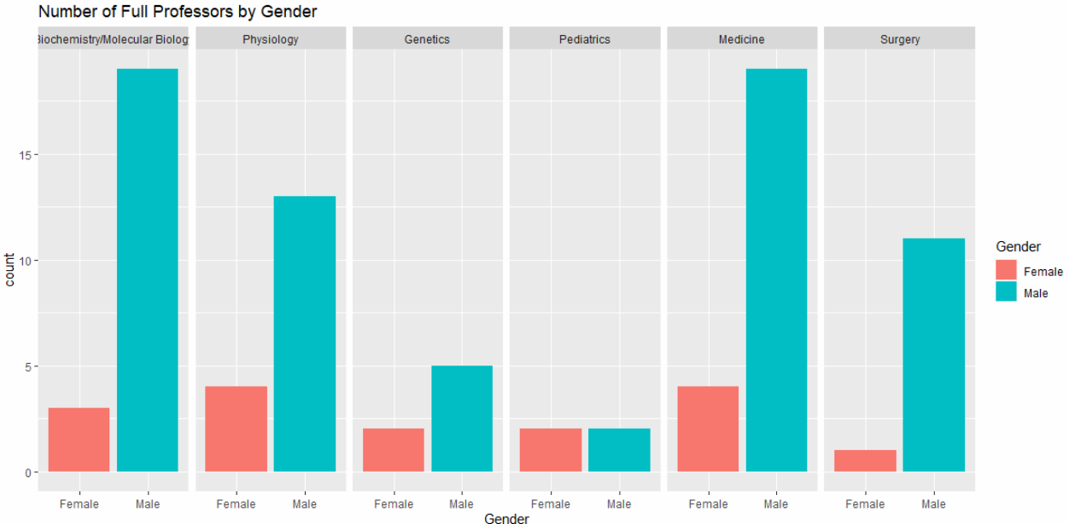
Analysis: Number of Full professors
Grouped by Department
Across all departments, the number of male Full Professors is disproportionately larger than that of females. Only one of the six departments (Pediatrics) have the same number of male and female Full Professors, with males dominating the other departments.
Gabriella

Slide 7
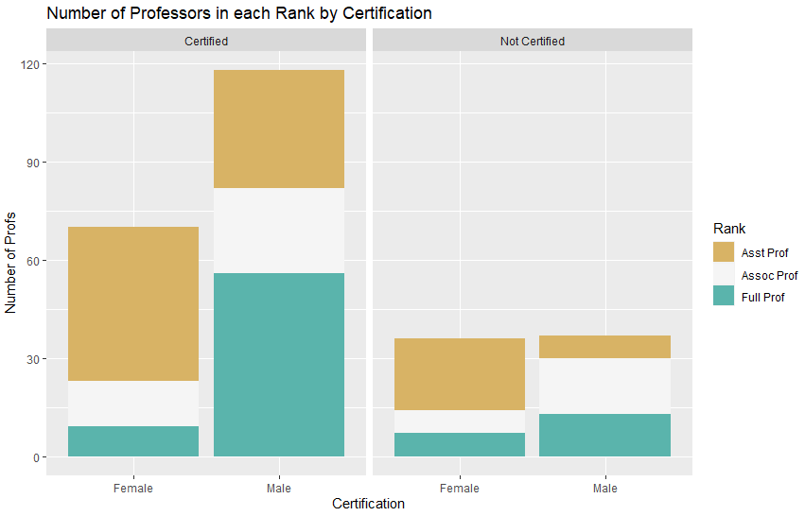
Analysis: Overall Proportion of Professors’ Rank
Grouped by Certification
There are more male Full Professors than female Full Professors, and more female Assistant Professors than male Assistant Professors. It displays an unfair ratio of the number of full professors despite the fact that females are fully certified for the job. It is even more shocking to see that there is a higher number of uncertified male full professors than the certified female professors.
Gabriella

Slide 8
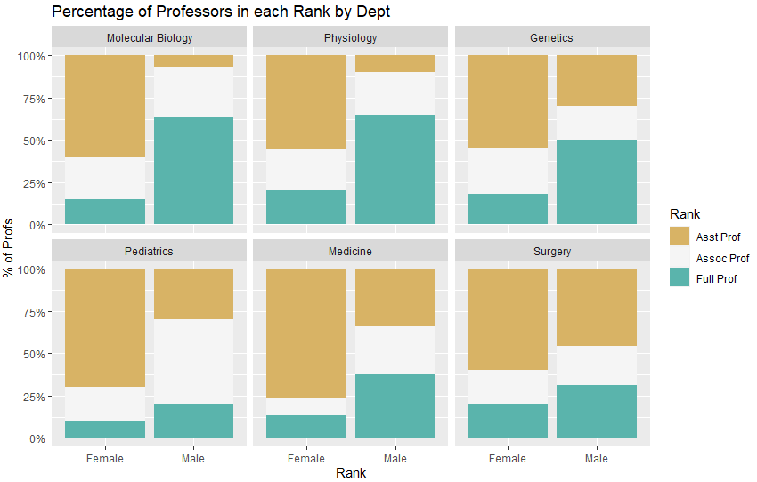
Analysis: Proportion of Professors’ Rank
Grouped by Departments
Across all departments, there is a lower percentage of female Full Professors and higher percentage of female Assistant Professors. This can be seen by the clear shape formed by each of the graphs, where the left yellow bar is always taller than the right and the right blue bar is always taller than the left.
Justyn

Slide 9
Conclusion
Discrimination in: SALARY
For the entire university, males are unequivocally paid more than females.
This trend worsens year-on-year and is regardless of Rank and Experience levels.
----
This highlights the systemic discrimination against females for pay, in violation of the Equal Pay Act which posits to pay the same salary for substantially equal work and working conditions. These are clearly the same based on the metrics of Rank (“a proxy for productivity”), making this pay gap unjustified.
Discrimination in: RANK PROMTION
The evidence clearly shows that males in the university are more likely to be full professors than assistants while the opposite is true for females.
----
The promotion statistics clearly shows the evident discrimination UH has in promoting their staff where gender plays a significant role in how they deliver their promotion. This goes against the values of a meritocratic society of rewarding purely on the basis of contributions.
Rodmond

Slide 10
THANK YOU
BC2402 Analytics I
AY21/22
Seminar 2 Team 7

